Slide 1

Rock buster Stealth LLC Data Analysis Project
Padma Kumari Mullapudi

Slide 2
Introduction
Rockbuster Stealth LLC is a movie rental company that used to have stores around the world. Facing stiff competition from streaming services the Rockbuster Stealth management team is planning to launch an online video rental service in order to stay competitive. Our goal for this analysis is to provide data-driven answers to key questions asked by Rockbuster Stealth Management Board to develop a company strategy for 2020.

Slide 3
Strategy Questions
Which movies contributed the most/least to revenue gain?
What was the average rental duration for all videos?
Which countries are Rockbuster customers based in?
Where are customers with a high lifetime value based?
5. Do sales figures vary between geographic regions?

Slide 4
Which movies contributed the most/least to revenue gain?

Slide 5
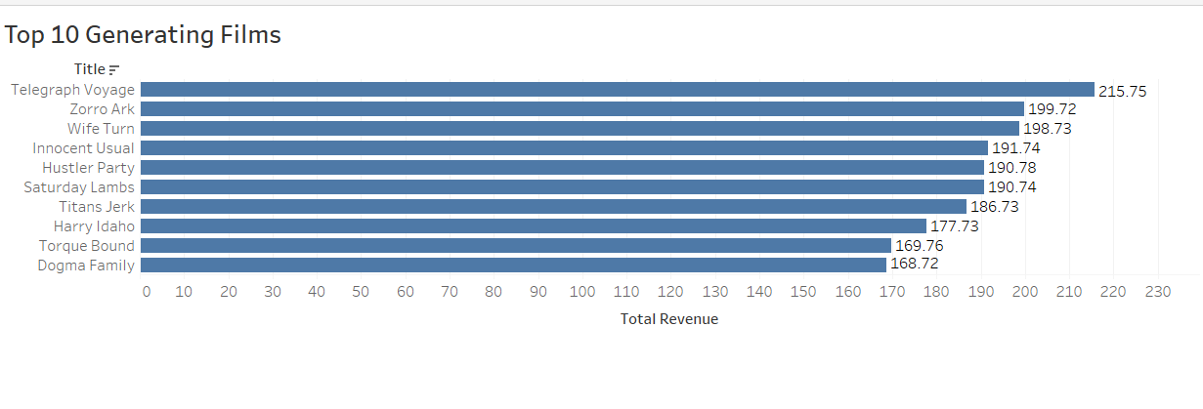
Top 10 Most Revenue Generating Films

Slide 6
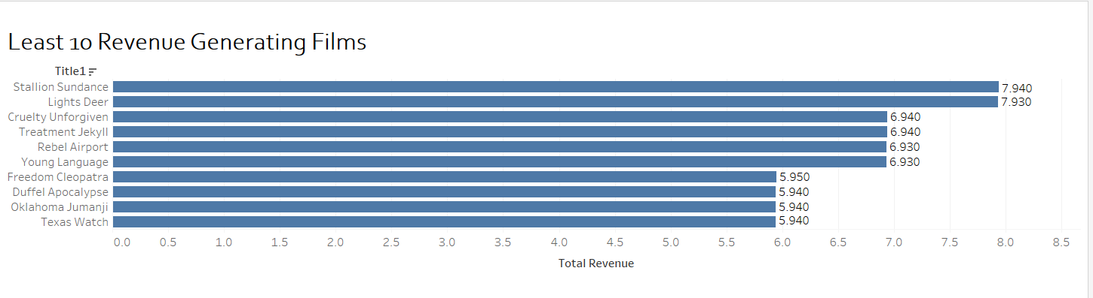
Top 10 Least Revenue Generating Films

Slide 7
What was the average rental duration for all videos?

Slide 8
Average rental duration for all videos
The average rental duration for all the videos is 4.9 Days

Slide 9
Which countries are Rockbuster customers based in?

Slide 10
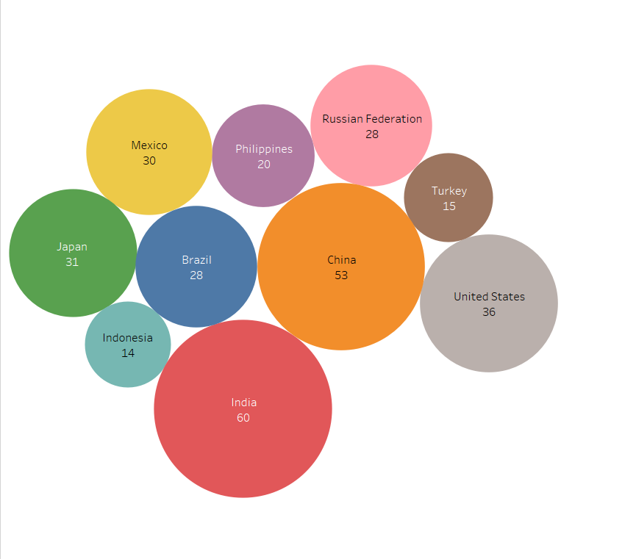
Countries with Rockbuster Customers
Rockbuster has customers worldwide, the top 10 countries

Slide 11
Where are customers with a high lifetime value based?

Slide 12
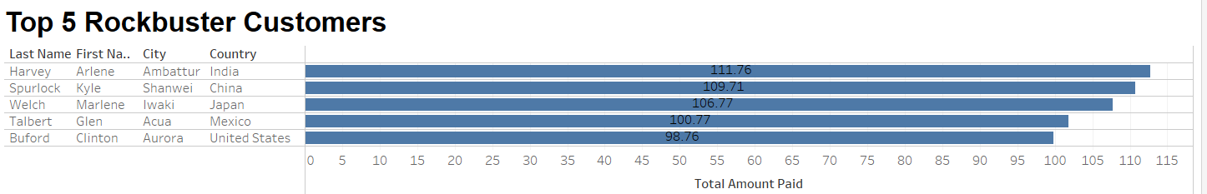
Top 5 Customers

Slide 13
Do sales figures vary between geographic regions?

Slide 14
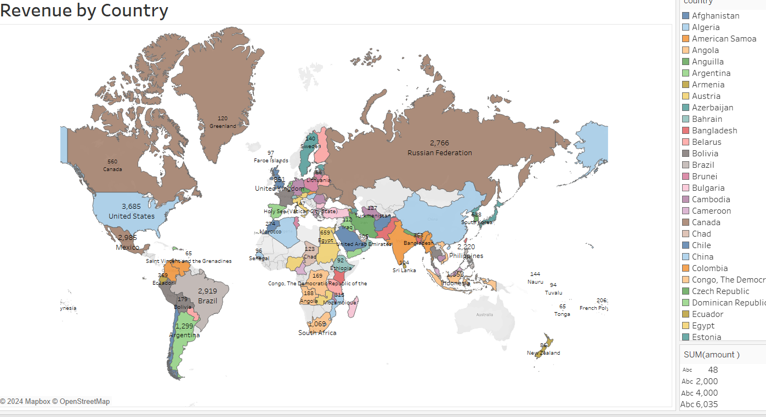
Revenue by Country

Slide 15
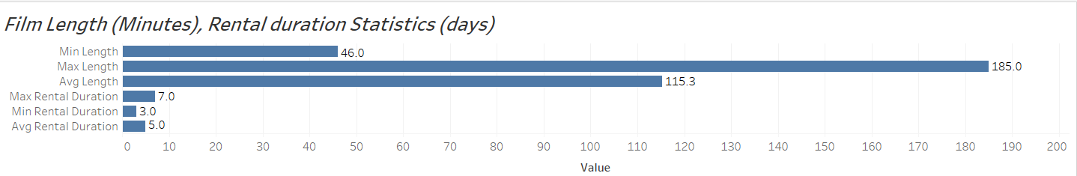
Film Length, Rental duration Statistics

Slide 16
Conclusion
Summary
•
Average rental duration: 4.985 days
•
Average rental rate: $ 2.98
•
Asia is the most popular region for Rockbuster
•
Countries with the most customers:
•
India, China, United States, Japan, and Mexico
•
Movies that made the most revenue:
•
Telegraphic Voyage, Zorro Ark, Wife Turn
Average rental duration: 4.985 days
Countries with the most customers:
India, China, United States, Japan, and Mexico
Movies that made the most revenue:
Telegraphic Voyage, Zorro Ark, Wife Turn

Slide 17
Recommendations
Evaluate and potentially exclude low-revenue movies, giving priority to those in higher demand among the audience.
Introduce loyalty programs aimed at rewarding and retaining dedicated, long-term customers.
Consider removing low revenue movies and prioritize movies with higher audience demands.

Slide 18
Thank You https://public.tableau.com/app/profile/padma.kumari.mullapudi

